Slide 1
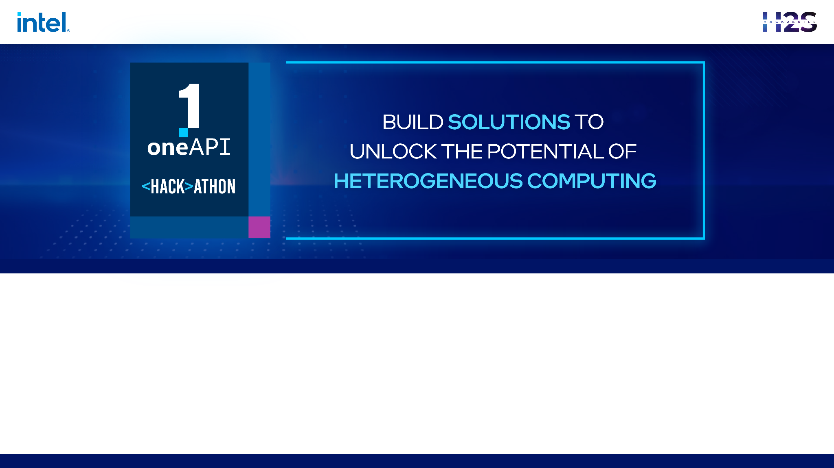
Team Name : Team SRM
Problem Statement : Object Detection For Autonomous Vehicles

Slide 2
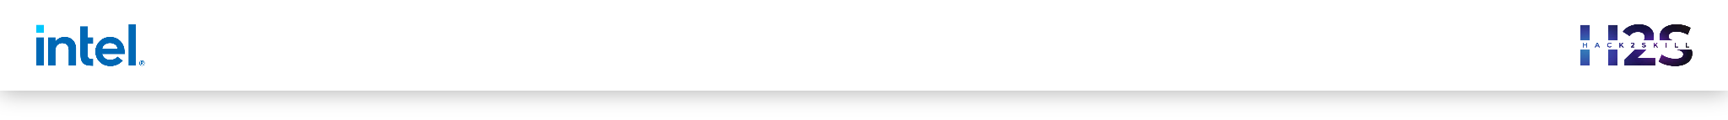

Brief about the Idea
The input dataset is a combination of various datasets that we will be using for the problem statement. Preprocessing the dataset includes Normalisation and Augmentation.
The dataset is then split into three parts mainly Training(80%), Testing(10%) and Validation(10%) datasets.
The model then classifies, detects and segments the object accordingly.

Slide 3
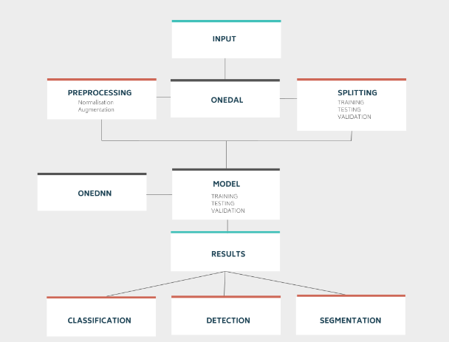
Process Flow Diagram

Slide 4
Opportunity
Object detection provides opportunity to identify and track other vehicles, pedestrians, and obstacles in the road, allowing them to navigate safely and avoid collisions.
To solve the problem our neural network classifies,detects and uses semantic segmentation
How does it classifies? The CNN achieves this by using convolutional layers to extract relevant features from the input image, and then passing those features through fully connected layers to produce the final classification.

Slide 5
How does it detects? Approach for object detection is to use a region-based CNN, such as the Faster R-CNN or YOLO models.
How does it semantic segmentation? The CNN accomplishes this by using convolutional layers to extract feature maps from the input image, and then applying a series of convolutional and upsampling layers to produce a dense classification map at the same resolution as the input image.

Slide 6
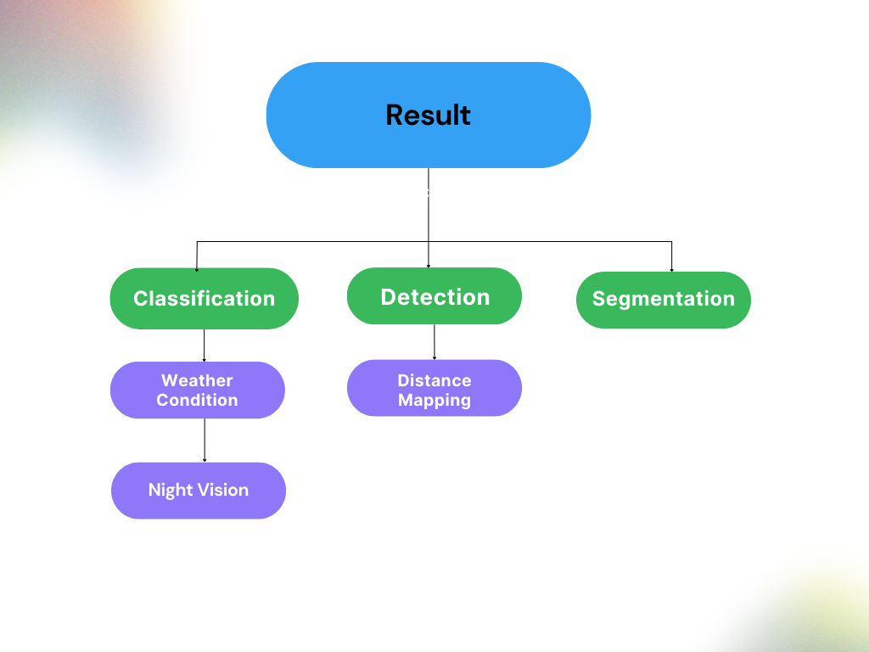
List of features offered by the solution

Slide 7
List of oneAPI Ai Analytics Toolkits, its libraries and
the SYCL/DPC++ Libraries used
Tools | Component
AI Analytics toolkit | Intel Optimization for TensorFlow Intel Neural Compressor Intel Extension of Scikit-learn Intel Distribution of Modin(oneDAL)
CPU and GPU processing | SYCL DPC++

Slide 8
Technologies used
Technology | Component
Frameworks | Opencv Tensorflow scikit-learn
Languages | Python C++

Slide 9
Team Members:
Varsha Nagarajan(varsha-1004 (Varsha Nagarajan) (github.com))
Himanshu Kumar(hemnsue (Himanshu Kumar) (github.com))
Praveen Dev(praveendev1313 (github.com))
Aditya Jambhale(adijams01 (Aditya Jambhale) (github.com))

Slide 10
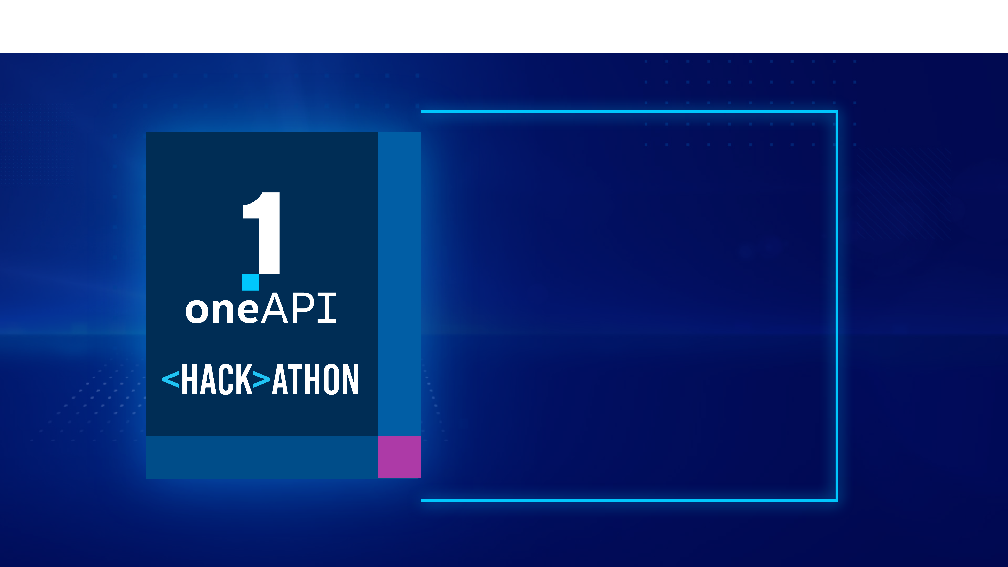
THANK YOU

